Slide 1
Basics of Computing

Slide 2
What is Computing?
Computing is the process of using and improving computer technology, computer hardware and software to complete a given goal-oriented task.

Slide 3
Types of Computing
Monolithic
Distributed
Parallel
Collaborative

Slide 4
Monolithic Computing
simplest form of computing.
A single computer such as personal computer is used for computing.
It is not connected to any network.
It can use resources only within its immediate access.
There are two types:
single user monolithic computing
multi-user monolithic computing

Slide 5
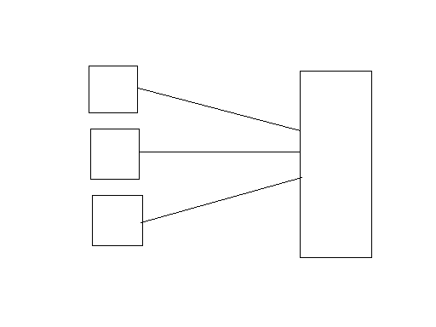
Monolithic Computing
Examples: Use of applications such as word processing program or a spreadsheet on a PC
Resources can be shared by concurrent users – using “Time Sharing” technique
Terminals
Main frame

Slide 6
Distributed Computing
performed in a distributed system
What is a distributed system?
A distributed system is a collection of independent computers that appear to the users of the system as a single system.
Eg: Enterprise Applications

Slide 7
Definitions
“A distributed system consists of multiple autonomous computers that communicate through a computer network”.
“Distributed computing utilizes a network of many computers, each accomplishing a portion of an overall task, to achieve a computational result much more quickly than a centralized computing .”

Slide 8
Distributed System Characteristics
To present a single-system image:
Hide internal organization, communication details
Provide uniform interface
Easily expandable
Adding new computers is hidden from users
Continuous availability
Failures in one component can be covered by other components

Slide 9
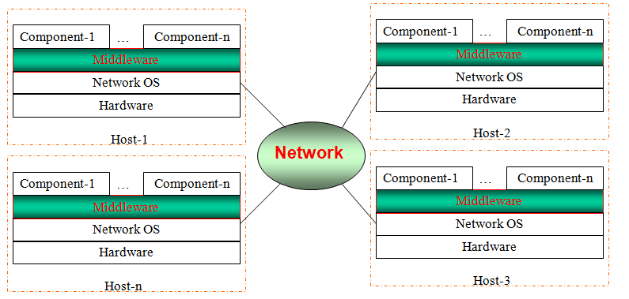
Distributed Systems
The middleware layer runs on all machines, and offers a uniform interface to the system

Slide 10
Examples of Distributed Computing
WWW is an excellent example of this type of computing
A browser to visit a web site - a program such as Internet Explorer - runs on local system and interacts with a program(known as web server) - which runs on remote system to fetch a file or resource

Slide 11
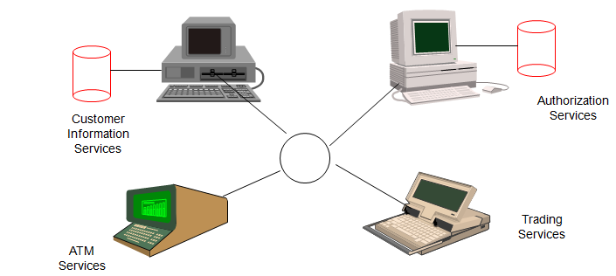
IT Service Architecture of a Bank
Service architecture consists of heterogeneous new and legacy components
Hardware platforms range from mainframes to NTs
Programming languages including Assembler, Cobol, C, C++, Java, …
Different types of middleware can be used to resolve distribution and heterogeneity

Slide 12
Strengths of Distributed Computing
Availability, Reliability, high fault tolerance: A system crash on one server does not affect other servers.
Scalability: Can add more machines as needed.
High performance: Compared to centralized computer network clusters, it can provide higher performance.

Slide 13
Resource Sharing: Ability to use any hardware, software or data anywhere in the system.

Slide 14
Transparency in Distributed Systems
Transparency:-
make certain aspects of distribution are invisible to the application programmer .
They not concern the locations and details of how it operate, either replicated or migrated.
Failures can be presented to application programmers in the form of exceptions – must be handled.
Dimensions of transparency in DS
Access Transparency
Location Transparency
Migration Transparency
Replication Transparency
Concurrency Transparency
Scalability Transparency
Performance Transparency
Failure Transparency

Slide 15
Access transparency: enables local and remote resources to be accessed using identical operations.
Location Transparency: users cannot tell where hardware and software resources such as CPUs, printers, files, data bases are located.
Migration Transparency: resources must be free to move from one location to another without their names changed.
Replication Transparency: OS can make additional copies of files and resources without users noticing.

Slide 16
Concurrency Transparency: The users are not aware of the existence of other users. Need to allow multiple users to concurrently access the same resource. Lock and unlock for mutual exclusion.
Scaling transparency: allows the system and applications to expand in scale without change to the system structure or the application algorithms.

Slide 17
Performance transparency: allows the system to be reconfigured to improve performance as loads vary.
Failure transparency: enables the concealment of faults, allowing users and application programs to complete their tasks despite the failure of hardware or software components.

Slide 18
Security issues: The characteristics of open systems make data security and sharing risks in distributed computer systems.
Multiple points of failure: failure of one or more computers or one or more network links can cause trouble for distributed computing

Slide 19
Architectural models of distributed computing
Describes responsibilities distributed between system components and how are these components placed.
Client-server
Peer-To-Peer
Hybrid

Slide 20
Client-server model
The system is structured as a set of processes, called servers,
that offer services to the users, called clients.
The client-server model is usually based on a simple request/reply protocol,
Eg. Implemented with send/receive primitives or using remote procedure calls (RPC) or remote method invocation (RMI)
The client sends a request (invocation) message to the server asking for some service;
The server does the work and returns a result.

Slide 21
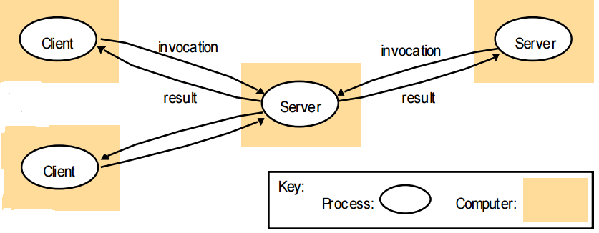
Client/Server
functional decomposition
Ex: workstations that use a mail server to exchange messages

Slide 22
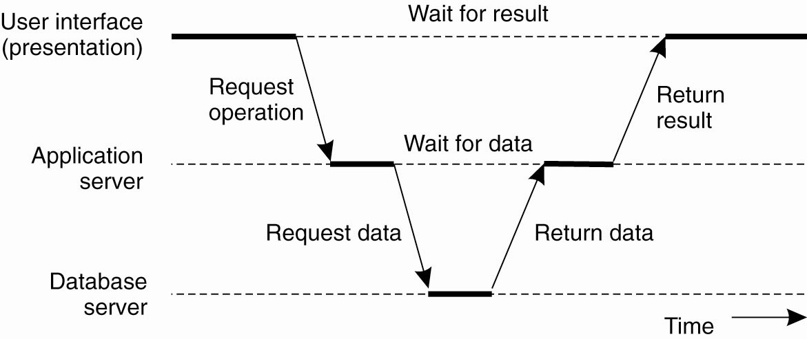
Multitiered Architectures (3 Tier Architecture)

Slide 23
Peer-To-Peer
The “peers” are computer systems which are connected to each other via the Internet.
Files can be shared directly between systems on the network without the need of a central server.
Each computer on a P2P network becomes a file server as well as a client.
have equal rights for initiating communication with each other, sharing resources, and validating users.

Slide 24
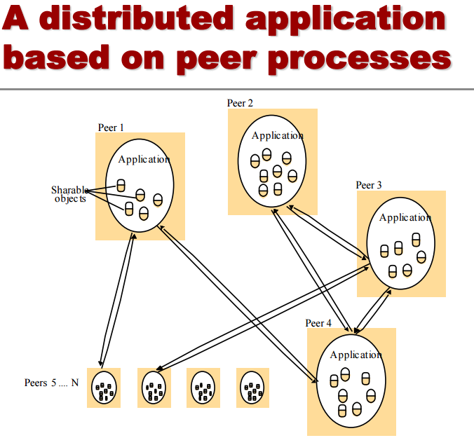
Peer-to-peer
physical decomposition into identical components Ex: the exchange of mail messages among hosts

Slide 25
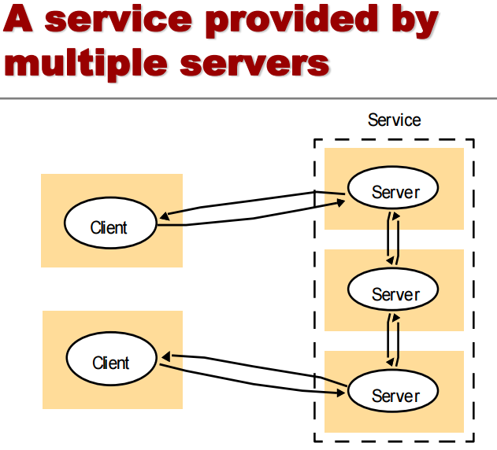
Hybrid
physical and functional decomposition Ex: a collection of servers provide a service for some of the clients

Slide 26
Parallel Computing
Parallel computing refers to the process of breaking down larger problems into smaller, independent, often similar parts that can be executed simultaneously by multiple processors communicating via shared memory, the results of which are combined upon completion as part of an overall task.

Slide 27
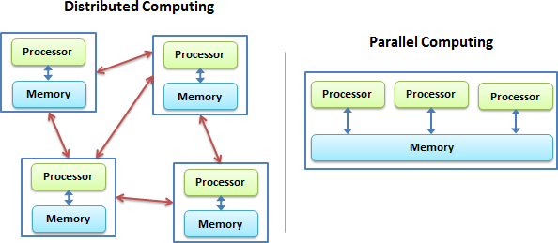
Shared memory
Distributed memory

Slide 28
Collaborative
diverse collection of information technologies designed to support work between individuals.
These kinds of technologies retrieve and share data with the individuals working together, who can then update or annotate it as needed.
Collaborative Computing Group · GitHub

